Slide 1
Image Processing . Helmet Detection

Slide 2
CONTENTS
Introduction and Approach | Detect if people are wearing helmets via traffic camera footage
Why YOLO | YOLO offers fast, accurate detection ideal for real-time needs
Observations | Inaccuracies and Inabilities of the Model for some video footages
Improvements | Improving the Search Algorithm
Real World Application | No Green Light till you wear a helmet
Future Work | Ideas of improving the feature beyond Yolo’s training

Slide 3
01
Introduction
Problem Statement and Approach

Slide 4
Problem and Approach
The problem of helmet safety is significant, as many riders fail to wear helmets, increasing the risk of injury in accidents. Our approach utilizes real-time traffic camera footage to detect whether individuals are wearing helmets. By implementing the YOLO (You Only Look Once) object detection model, we aim to accurately identify helmet usage, enhancing road safety measures and providing valuable data for enforcement.

Slide 5
02
Why YOLO
Why it’s a popular approach

Slide 6
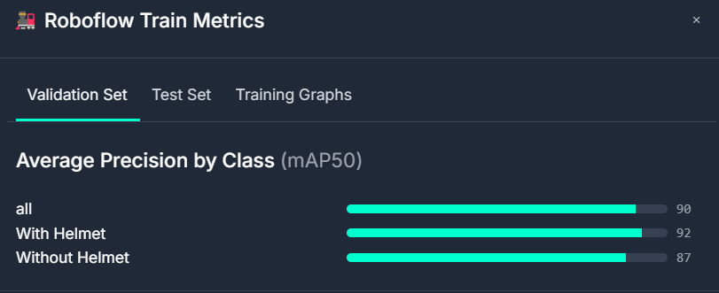
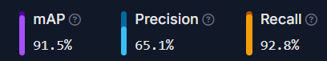
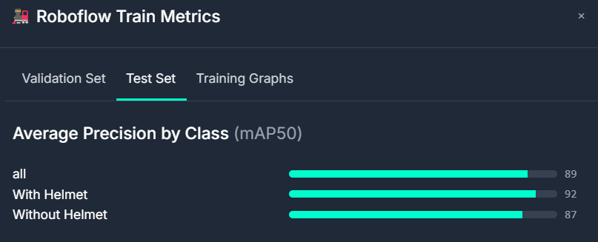

Slide 7
03
Observations
Why Brute Force is not Optimal

Slide 8
Inaccuracies of the current model
Despite the effectiveness of the YOLO model, several challenges limit its ability to detect every individual in the video. Key factors include:
Occlusion: Many riders may be partially obscured by vehicles or other objects, making detection difficult.
Low Resolution: Some video feeds may lack clarity, hindering the model's ability to identify helmets accurately.

Slide 9
04
Improvements
Pushing beyond YOLO’s limit

Slide 10
Handling Undetected People
To improve detection, we used a sliding window approach, scanning the frame in smaller, overlapping segments. This method allows us to capture more sub-regions, increasing the number of helmets detected beyond the usual maximum of three. By systematically traversing the frame, we enhance the model's ability to identify individuals who might otherwise be missed due to occlusion or placement.
This results in better overall monitoring of helmet usage in traffic scenarios.

Slide 11
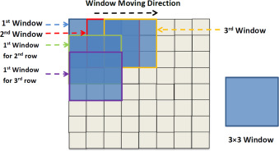
Sliding Window

Slide 12
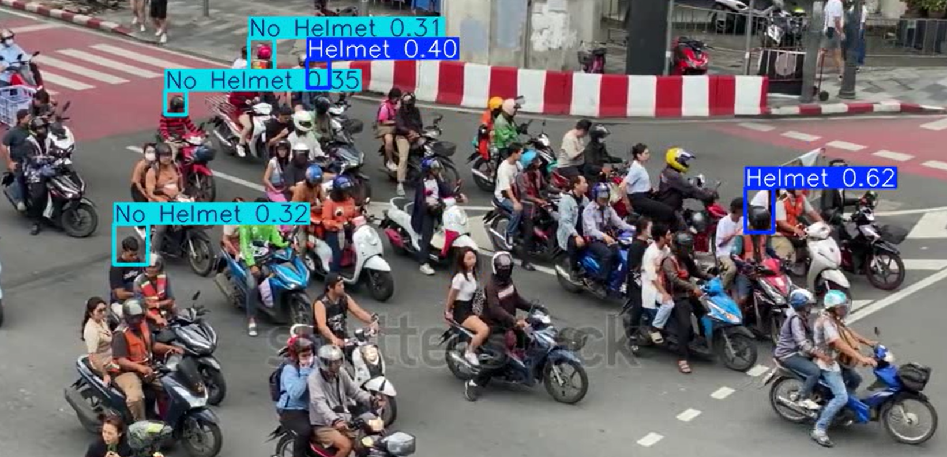
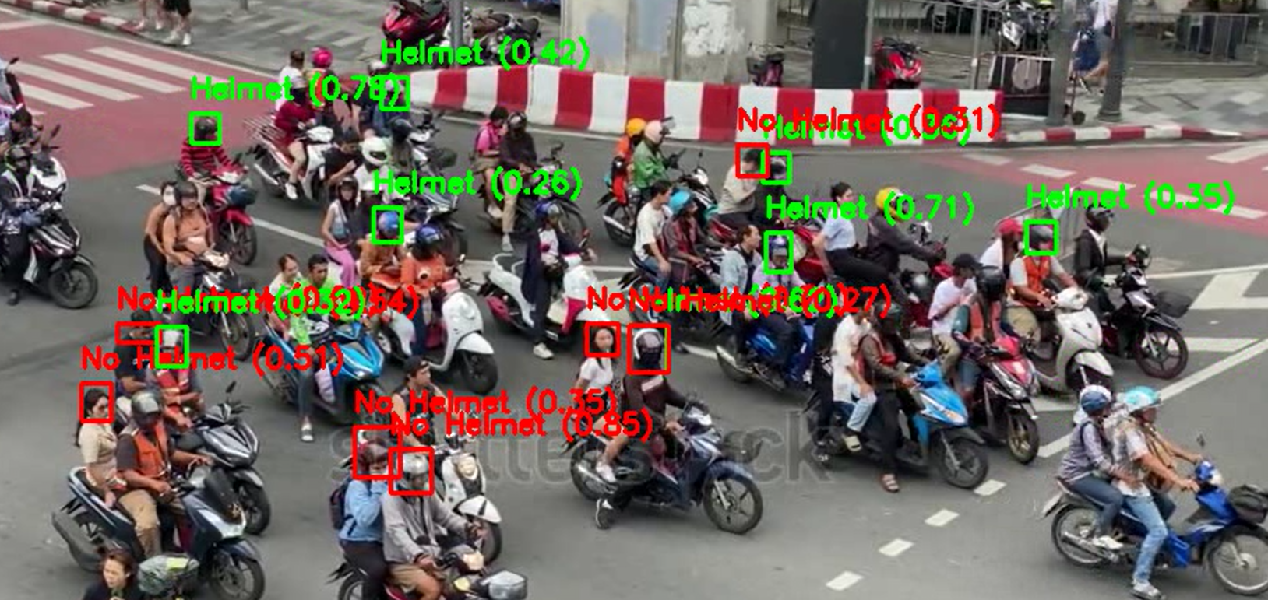
Before vs After

Slide 13
05
Real World Application
Inspired by Honda’s Traffic Safety Ad

Slide 14
No Green Light till you wear a Helmet
The "No Green Light till you wear a Helmet" feature enhances safety by displaying real-time alerts for individuals not wearing helmets while riding. The system processes two video streams simultaneously: one for detecting helmet presence and another showing the original footage.
Key functionalities include:
Real-time Detection: It identifies riders with helmets, marking compliant ones with green bounding boxes and non-compliant ones with red.
Cropped Visual Feedback: Images of detected riders without helmets are cropped from the original video and arranged in a grid layout on a second screen.
This feature effectively reinforces the importance of helmet use by providing instant visual feedback to promote rider safety.

Slide 15
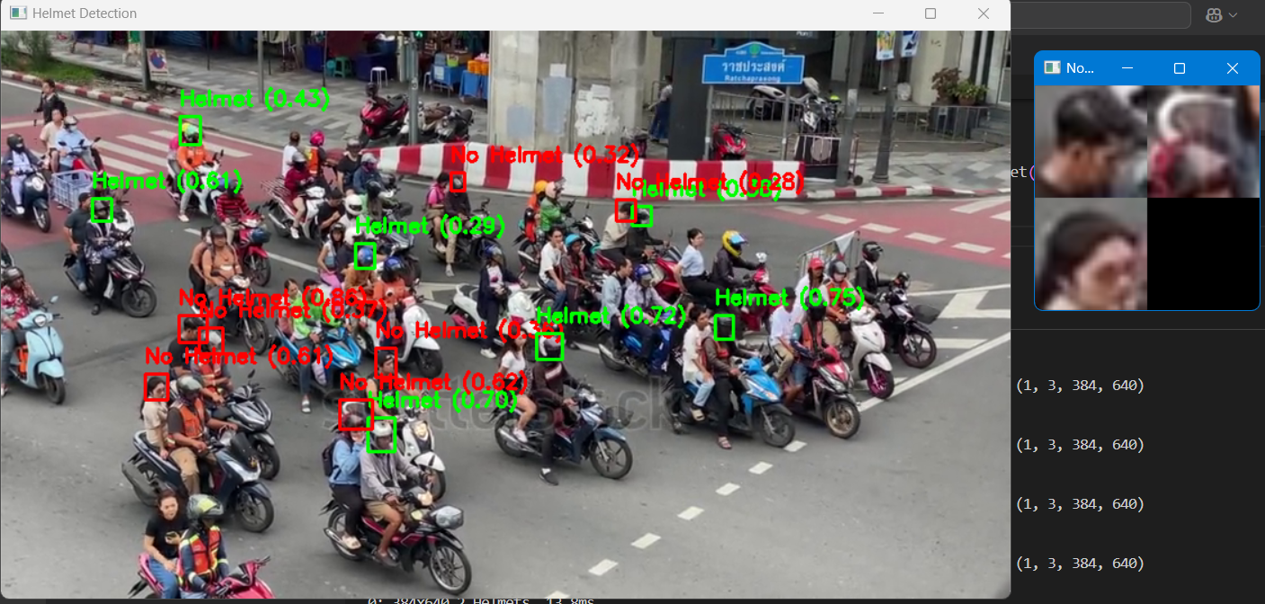
Model Processing vs. Output in second screen

Slide 16

WORK FLOW
Process Frames
Detect Helmets
Process Image Segments
Display People without Helmets on a second screen

Slide 17
06
Future Work
Object Tracking for Helmet Detection

Slide 18
Using Object Tracking over a series of Frames
Purpose: Monitor individuals’ helmet usage over time to enhance accuracy.
Initial Detection:
Detect individuals and assign unique IDs.
Tracking:
Use algorithms (e.g., Kalman Filter) to follow individuals across frames.
History Collection:
Record helmet status (helmet or no helmet) over time.
Majority Classification:
Determine status based on the majority of detections (e.g., 4 "no helmet" and 1 "helmet" means classify as "no helmet").
Results Display:
Show images of individuals consistently without helmets on a second screen for safety awareness.
Benefits:
Increased Accuracy: Reduces false positives.
Behavior Context: Assesses helmet usage over time.
Reliable Evaluation: Adjusts based on historical data.

Slide 19

THANK YOU

